Slide 1
Comparing Current Housing Prices to Expected Housing Prices in Minneapolis/St.Paul
Ben Peters
05/07/2026

Slide 2
Agenda
Goal/Reason for Modeling
Available Data
Plan for Data Workup and Modeling
Data Cleanup Strategy
Exploratory Data Analysis
Summary of Modeling Outcomes
Final Conclusions
Next Steps

Slide 3

Predicting Minneapolis/St.Paul Housing Data: Why Do it?
For the general home buyer, why a price is set the way it is may not make sense
Why is one home much more expensive than the other?
This may lead the home buyer to pay way too much for a house, or miss an incredible deal
In order for the homebuyer to have a better idea of housing costs, a model could be used to predict the cost, and then the home buyer could compare to the expected price given by the model
Image from: Minneapolis Housing Market: Trends and Forecast 2025-2026

Slide 4
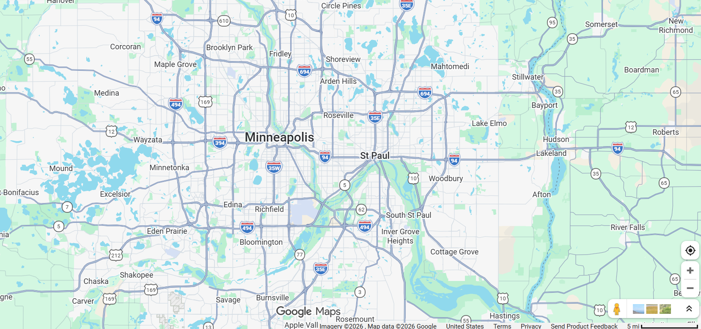
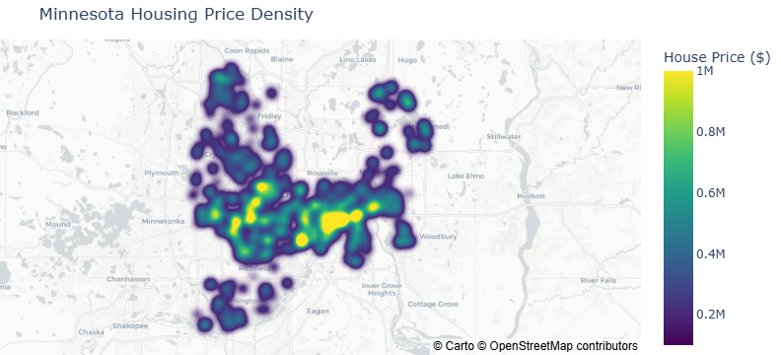
Data Overview:
All houses were on the market at the time the data was acquired
Initial dataset had 702 properties sourced from Kaggle/Redfin (CSV)
All properties were from the Minneapolis/ St. Paul area
Limiting the scope allows for less effects from differing laws, taxes, and other data that was not readily available
Data Sourced From: 🏡 United States - Redfin Housing Market (CSV)

Slide 5
Plan for Data Cleanup and Modeling
Removing Null Values and Specific Features
Feature/Price Correlation
Linear
Data Cleanup
Initial Data Analysis
Modeling
Random Forest
XGBoost

Slide 6
Plan for Data Cleanup and Modeling
Removing Null Values and Specific Features
Feature/Price Correlation
Linear
Data Cleanup
Initial Data Analysis
Modeling
Random Forest
XGBoost

Slide 7
Data Cleanup: Removing Null Values and Specific Features
Example 1: Features having only a single value
Example 2: Vacant Lots
Example 3: Removing rows missing all values
Housing type | Quantity
Single Family Residential | 430
Condo | 128
Multi-Family | 64
Townhouse | 60
Vacant Land | 13
Other | 5
Feature | Value
Sale Date | Null
State | MN
URL | URL for Redfin
There were two rows filled only with NaNs
These rows were removed
These columns for removed completely
All vacant land values were removed to focus on housing

Slide 8
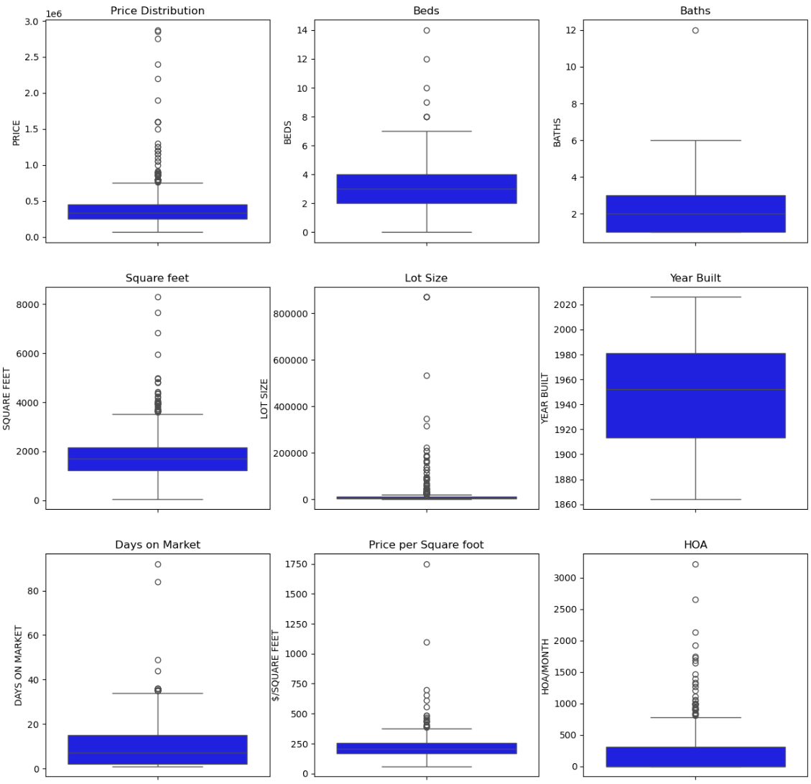
Data Cleanup: Dataset Summary
After removing features and rows:
14 features remain
687 rows remain
More data was removed through EDA as it became clear other data was not useful or redundant

Slide 9
Plan for Data Cleanup and Modeling
Removing Null Values and Specific Features
Feature/Price Correlation
Linear
Data Cleanup
Initial Data Analysis
Modeling
Random Forest
XGBoost

Slide 10
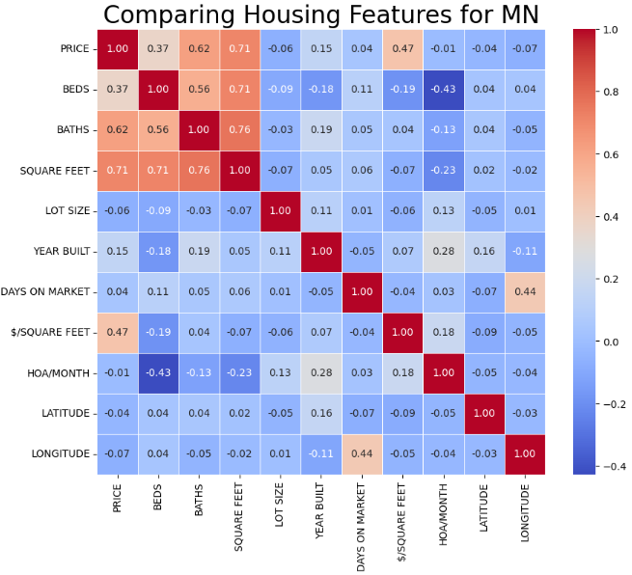
Feature Correlation with Housing Prices
All numerical features were compared to Price to determine if there are any correlations
Beds, Baths, Square feet and Price/Square foot all exhibited a positive correlation
Likely multicollinearity
Next step: Explore the relationships of these features with Price
Interestingly, the # Beds had a loose negative correlation with HOA/Month
Likely smaller residences such as condos

Slide 11
Feature Correlation with Housing Prices
All numerical features were compared to Price to determine if there are any correlations
Beds, Baths, Square feet and Price/Square foot all exhibited a positive correlation
Likely multicollinearity
Next step: Explore the relationships of these features with Price
Interestingly, the # Beds had a loose negative correlation with HOA/Month
Likely smaller residences such as condos

Slide 12
Feature Correlation with Housing Prices
All numerical features were compared to Price to determine if there are any correlations
Beds, Baths, Square feet and Price/Square foot all exhibited a positive correlation
Likely multicollinearity
Next step: Explore the relationships of these features with Price
Interestingly, the # Beds had a loose negative correlation with HOA/Month
Likely smaller residences such as condos

Slide 13
Feature Correlation with Housing Prices
All numerical features were compared to Price to determine if there are any correlations
Beds, Baths, Square feet and Price/Square foot all exhibited a positive correlation
Likely multicollinearity
Next step: Explore the relationships of these features with Price
Interestingly, the # Beds had a loose negative correlation with HOA/Month
Likely smaller residences such as condos

Slide 14
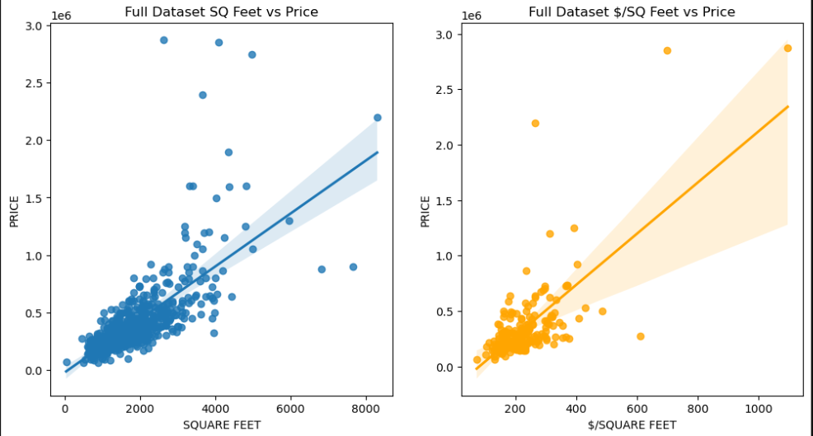
Feature Correlation with Housing Prices: Square Feet
Square feet has a weak correlation with price
This is expected as intuitively larger housing units cost more to build and are in higher demand
A similar conclusion can be made for Price per square foot
Feature removed for modeling purposes
R² = 0.504
P < 0.0001
R² = 0.220
P < 0.0001

Slide 15
Feature Correlation with Housing Prices: Square Feet
Square feet has a weak correlation with price
This is expected as intuitively larger housing units cost more to build and are in higher demand
A similar conclusion can be made for Price per square foot
Feature removed for modeling purposes
R² = 0.504
P < 0.0001
R² = 0.220
P < 0.0001
Feature Removed to Prevent Data Leakage

Slide 16
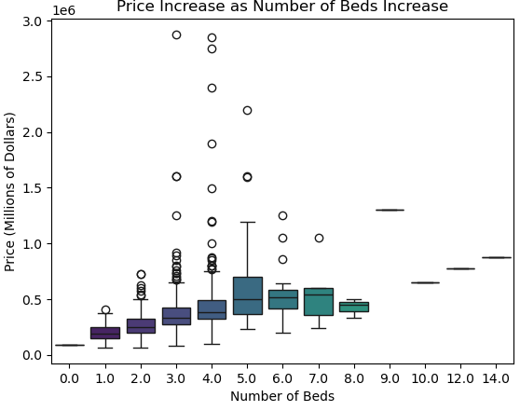
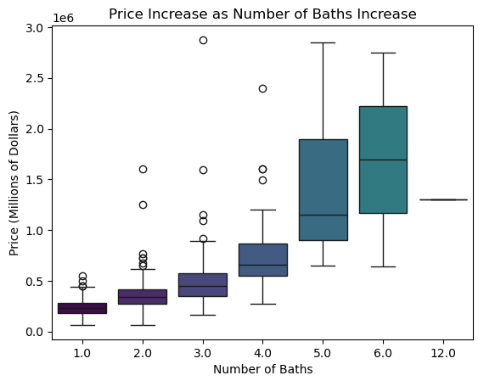
Feature Correlation with Housing Prices: Beds/Baths
Generally, As the number of beds and baths increase, the price increases
Price does not seem to increase after 5 beds (very large housing unit
Through a Pairwise Tukey significance test the price was found to be significantly different for groups of <3 beds, 3-5 beds, and >5 beds (p < 0.05)
Also using the pairwise Tukey significance test, groups of <3 baths, 3-4 baths, and >4 baths were all found to be significant (p < 0.05)

Slide 17
Choosing City, Zip, or Address?
There are a total of 687 houses remaining.
If ZIP or Location were used, then most rows would consist of a 0 and the number of features would become very large.
Potentially adding noise to the dataset
City was chosen to use for modeling to limit data dilution
Location Value | Total Unique Values | Average Samples per Category
City | 20 | 34.3
ZIP | 54 | 12.7
Location | 101 | 6.8

Slide 18
Preparing Data for Modeling
All Data
Numerical Data
Categorical Data
One Hot Encode
Scale
Split Data
First, Data is split into test and training sets
80% training, 20% testing
Second, all the categorical data needed to be one hot encoded
City, Property Type
25 extra features
Third, all the numerical data needed to be scaled
Standard Scaler
Testing set was scaled using parameters from the training set
Fourth combine numerical data and categorical data together keeping the training and testing datasets separate

Slide 19
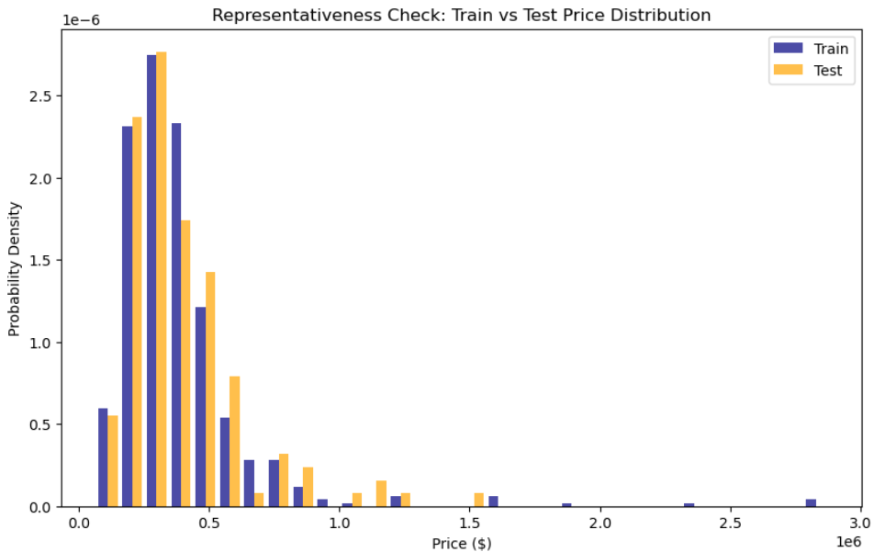
Train/Test Split of the Housing Data
The data was split as an 80 test/20 train split.
Data was stratified
The price range between the train and test split were very similar
Gives confidence that the training data and the testing data are representative of one another

Slide 20
Plan for Data Cleanup and Modeling
Removing Null Values and Specific Features
Feature/Price Correlation
Linear
Data Cleanup
Initial Data Analysis
Modeling
Random Forest
XGBoost

Slide 21
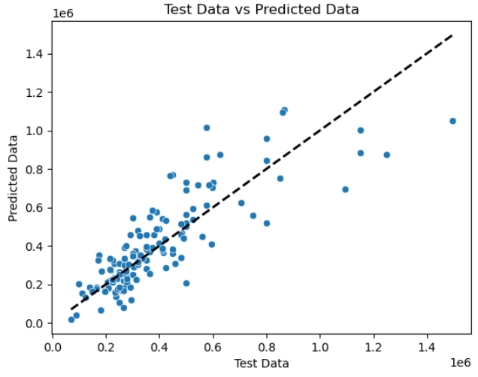
Linear Modeling Summary
Linear Model Performance
3 versions of the linear regression model were used
Ordinary Least Squared (OLS), Ridge, Lasso
Lasso kept 12 out of 32 features
Models were fit using a 5 fold cross validation strategy
Alpha values were optimized for lasso and ridge regression
Scoring was based of the mean absolute error
Considering the probable collinearity of some of the features (bed, bath, sq feet), these are not likely to be the best models
Still good to use as control models
Model | R² | MAE
# of samples | 135 | 135
Linear – Best Fit | 0.66 | $98,053
Linear – Ridge | 0.54 | $96,896
Linear – Lasso | 0.67 | $99,996

Slide 22
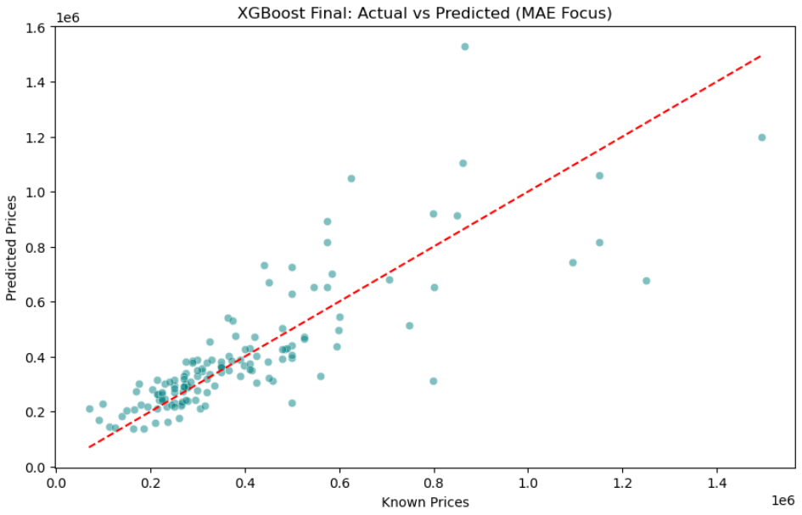
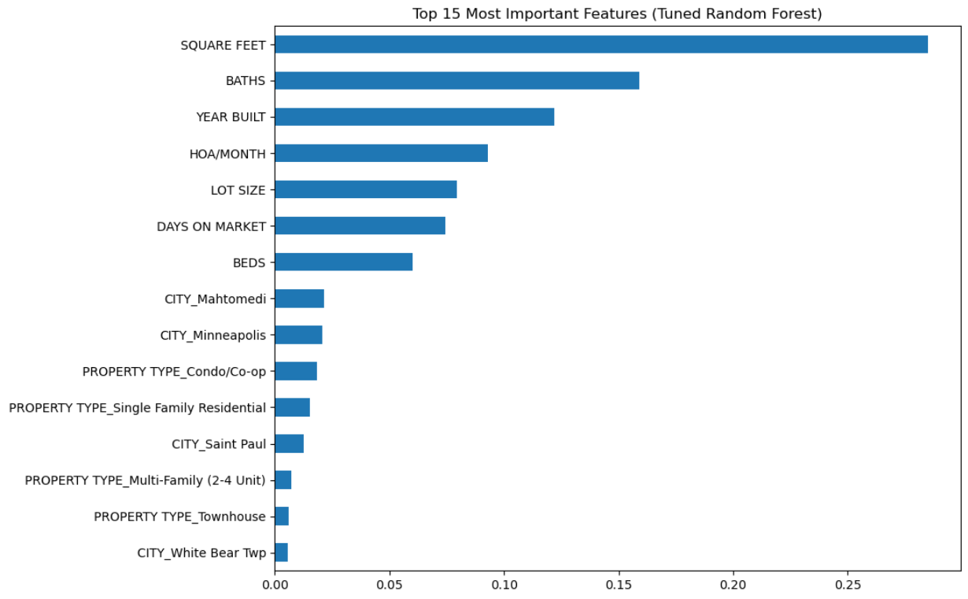
Random Forest Model Performance
Random Forest Summary
A randomized parameter search was used for optimization of the random forest model (Cross validation = 5)
Parameters optimized included:
Number of estimators – number of trees
Max depth – Max # of splits in each tree
Minimum sample split – Min # of splits in each tree
Minimum samples per leaf – limits new leaf to a sample amount
Maximum features – limits features per split
A grid search following the randomized optimization led to substantial overfitting
Scoring was based off the mean absolute error
Significant improvement from linear (~$98,000 error)
Model | R² | MAE
# of samples | 135 | 135
Random Forest | 0.66 | $88,425

Slide 23
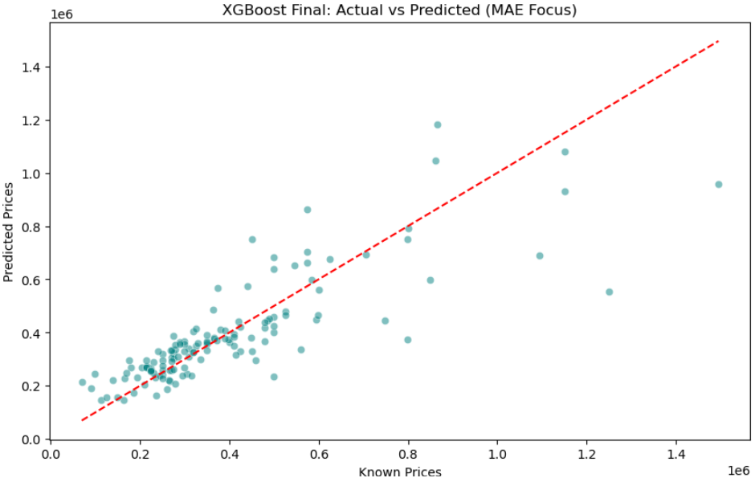
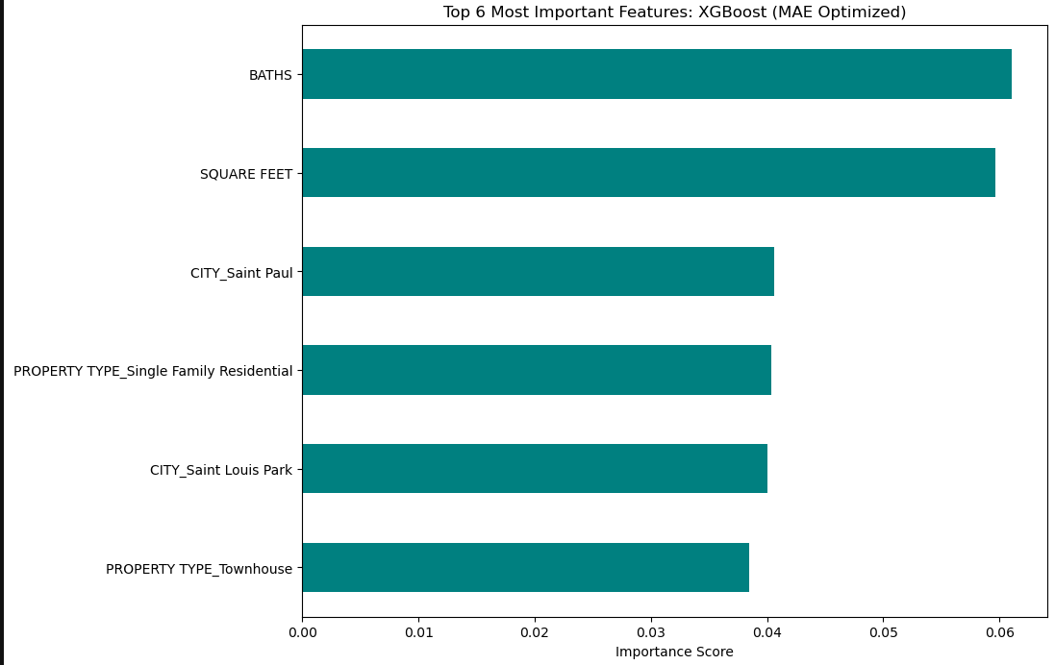
XGBoost Model Performance
XGBoost Summary
A randomized parameter search was used for optimization of the XGBoost forest model (Cross validation = 5)
Parameters optimized included:
Number of estimators – Rounds of optimization
Learning Rate – Rate at which the trees correct
Max depth – Tree Depth
Column Sample by tree - % of features used
Subsample - % samples used
Gamma – Split happens if greater than gamma
Scoring was based off the mean absolute error
Significant improvement from linear (~$98,000 error)
Model | R² | MAE
# of samples | 135 | 135
XGBoost | 0.68 | $82,132

Slide 24
Modeling Summary: Mean Average Error
After comparing the Mean Average Error, it seems as though XGBoost is the best model.
The error values seem high, but a $90,000 error is not as big of an error for a $1.5 million dollar house compared to a $500,000 dollar house.
Next, an analysis of how the models did with differing price ranges was conducted with Mean Absolute Percent Error.

Slide 25
Modeling Summary: Choosing the Best Model
Model | R² | MAE | Low Price (<$300K) | Med Price ($300K-$500K) | Med-High Price ($500K-$1M) | High Price (>$1M)
# of samples | 135 | 135 | 61 | 49 | 20 | 5
Linear – Best Fit | 0.66 | $98,053 | 30.51% | 21.40% | 24.81% | 26.45%
Linear – Ridge | 0.54 | $96,896 | 33.67% | 20.43% | 19.75% | 32.87%
Linear – Lasso | 0.67 | $99,996 | 32.78% | 22.14% | 23.82% | 26.83%
Random Forest | 0.66 | $88,425 | 28.62% | 16.90% | 24.38% | 30.04%
XGBoost | 0.68 | $82,132 | 27.24% | 15.57% | 21.00% | 30.78%
To understand the model limitations further, the Mean Absolute Percentage Error was determined for different pricing bins
XGBoost and exhibited the lowest error on the test dataset
* MAE = Mean Average Error

Slide 26
Modeling Summary: Choosing the Best Model
Model | R² | MAE | Low Price (<$300K) | Med Price ($300K-$500K) | Med-High Price ($500K-$1M) | High Price (>$1M)
# of samples | 135 | 135 | 61 | 49 | 20 | 5
Linear – Best Fit | 0.66 | $98,053 | 30.51% | 21.40% | 24.81% | 26.45%
Linear – Ridge | 0.54 | $96,896 | 33.67% | 20.43% | 19.75% | 32.87%
Linear – Lasso | 0.67 | $99,996 | 32.78% | 22.14% | 23.82% | 26.83%
Random Forest | 0.66 | $88,425 | 28.62% | 16.90% | 24.38% | 30.04%
XGBoost | 0.68 | $82,132 | 27.24% | 15.57% | 21.00% | 30.78%
To understand the model limitations further, the Mean Absolute Percentage Error was determined for different pricing bins
XGBoost and exhibited the lowest error on the test dataset
* MAE = Mean Average Error

Slide 27
Modeling Summary: Feature Importance

Slide 28

Conclusions and Next Steps
Conclusions
Depending on the price range, XGBoost is the best model
Ideally, these models would have less than 10% error
May need more data and feature engineering to make this happen
The models given here can give an idea as to whether a house is significantly over/under priced, but more refinement and data are needed to be more specific
Next Steps
Obtain more data – more housing information would be very helpful and would allow for separating the houses based on price for modeling of separate bins
Gather more information about features
Features such as if there is a pool, granite countertops, newly remodeled, distance from schools, etc.

